Slide 1
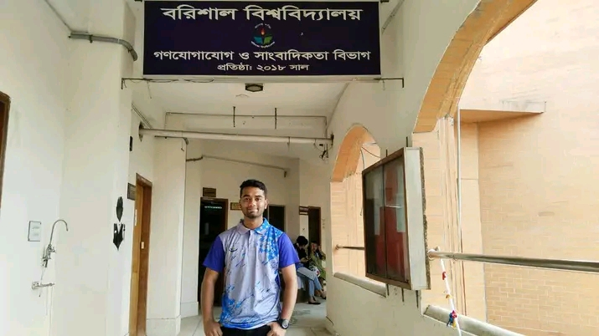
Welcome to my presentation
Name : Ashikur Rahman
Roll : 02 office 34

Slide 2
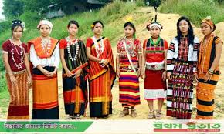
Topic festival and food of the indegenous community of bangladesh

Slide 3
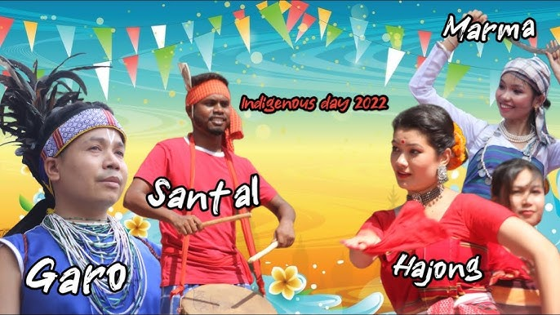
the indegenous community of bangladesh
Chakma
Marma
Santal
Garo

Slide 4
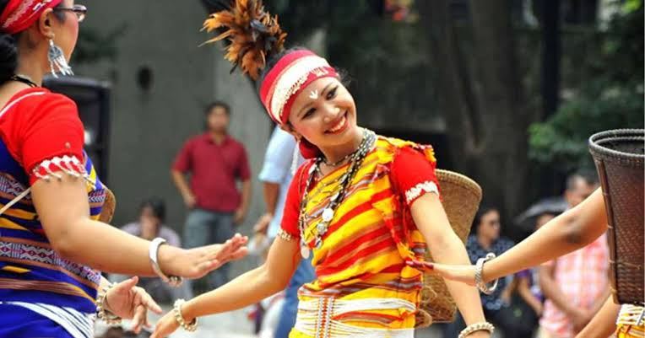

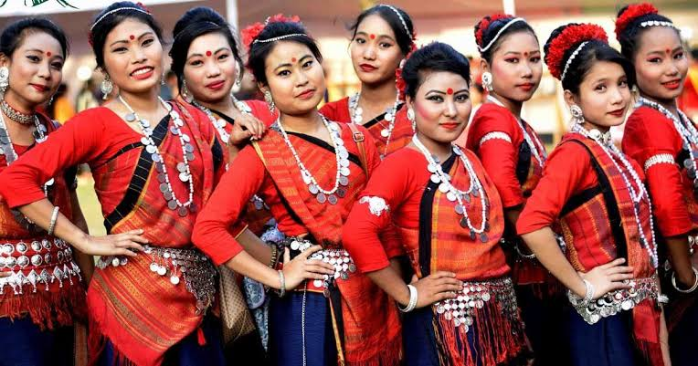
chakma community
The most important festival for the ‘’Chakma Community’’ is ‘’BIJO,” a three day Buddist festival that marks the chakm new year.

Slide 5
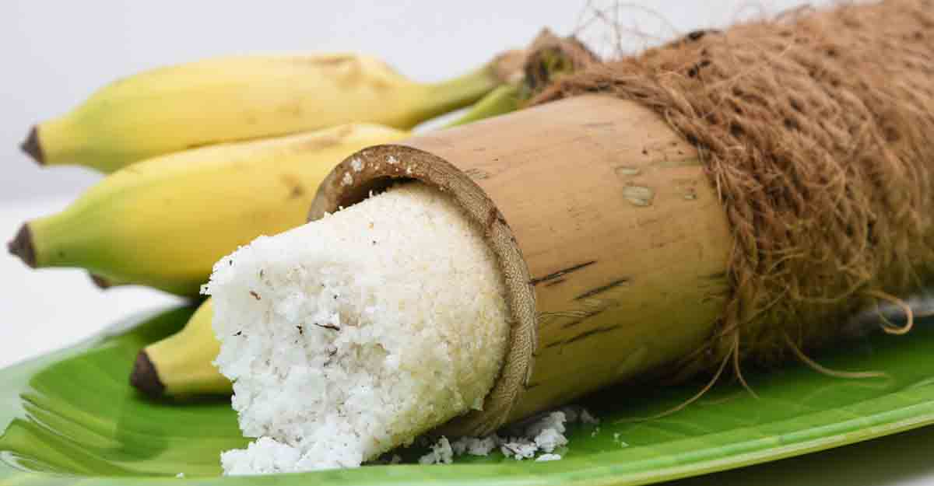
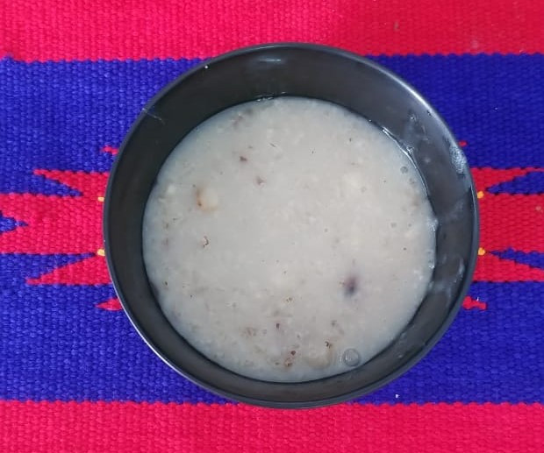
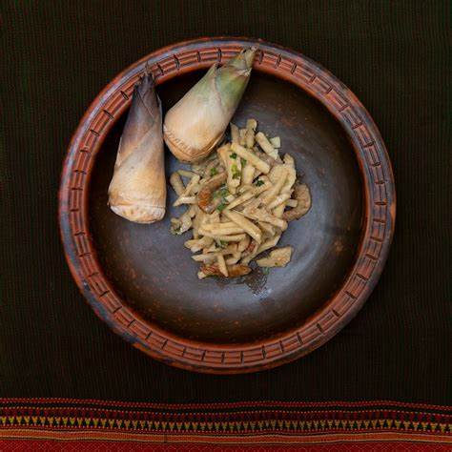
The traditional food of chakma
The staple food of the Chakmas is rice. In addition to rice, the other foods include Moikya (maize), Haun (millets), Hesh biji (grain), Jedena (barley), Bini chol (sticky rice). However, different food items are consumed between meals. One of the important traditional food items of the Chakmas is Pidhe (rice cakes).

Slide 6
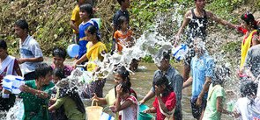
Marma community
The name of the Marma New Year festival is ' Sangrai '. This is one of their main traditional ceremonies. They organize this festival on the Bengali new year occasion of month Boishakh.

Slide 7
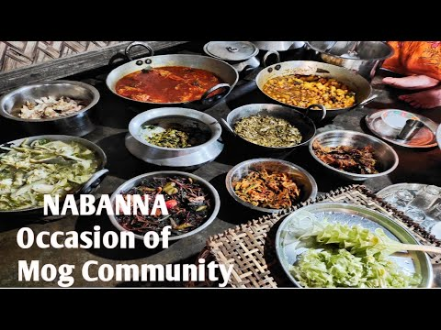
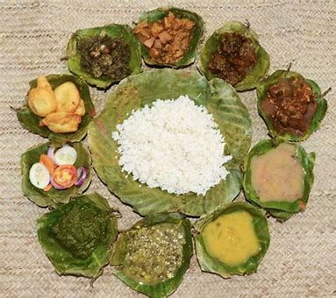
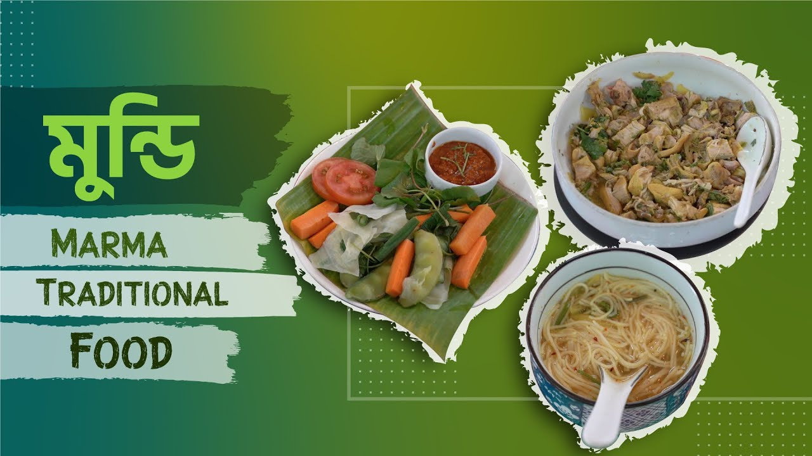
Traditional food of marma
Rice and boiled vegetables are major food items of the Marma people. ‘Nappi’ a paste of dried fish, is a favourite. They enjoy rice bear and smoke indigenous cigars.

Slide 8
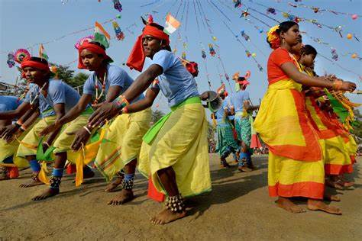
Santal community
The most important festival of the Santals is called Sohrai. It is the Harvest Festival celebrated after the rice harvest in early January. The celebrations stretch over several days. The first day is Um hiloah.

Slide 9
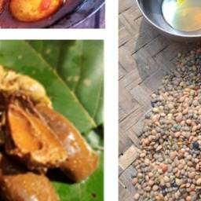
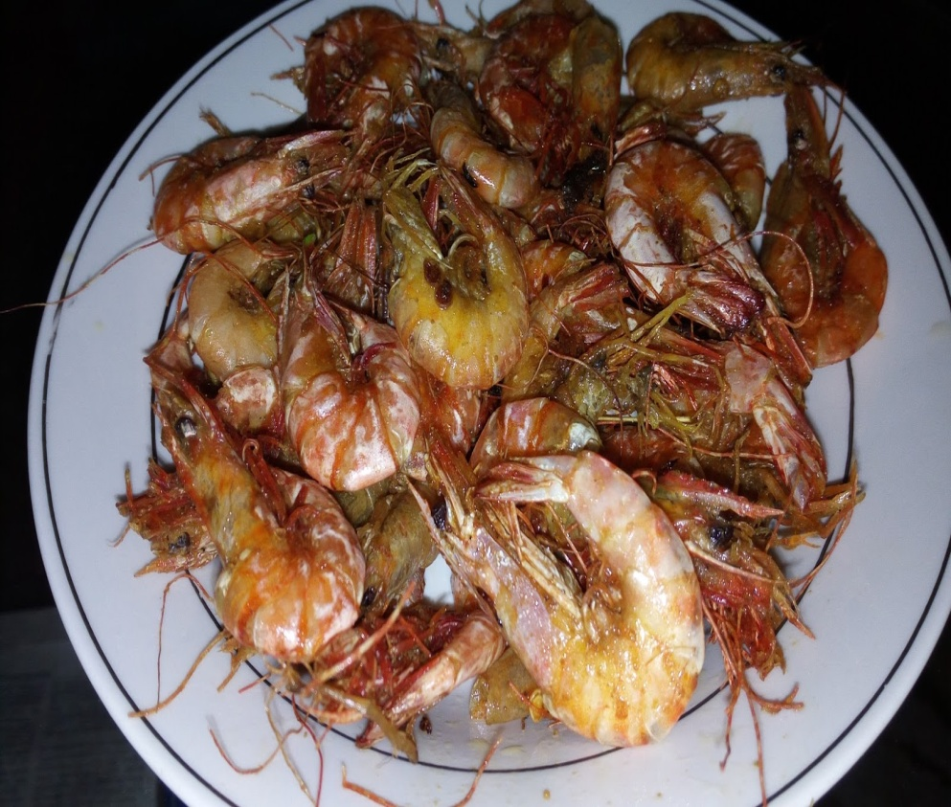
Traditional food of santal
The traditional food of the Santal community includes rice-based dishes like Handia and Pakhala, meat and fish curries, Pithe (sweet rice cakes), Chhatu (vegetable-stuffed rice flour dumplings), and Saru (palm sap drink), reflecting their agrarian lifestyle.

Slide 10
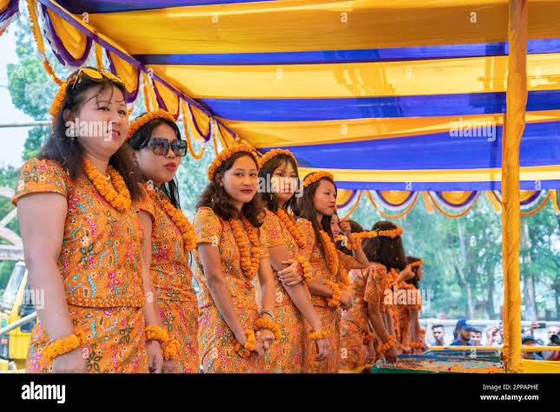
Garo community
The Garo community celebrates festivals like Baisaku (New Year), Wangala (the festival of 100 drums), and Chidekala (harvest festival). These festivals involve dancing, feasting, music, and traditional rituals, celebrating agricultural harvests and their rich cultural heritage.

Slide 11
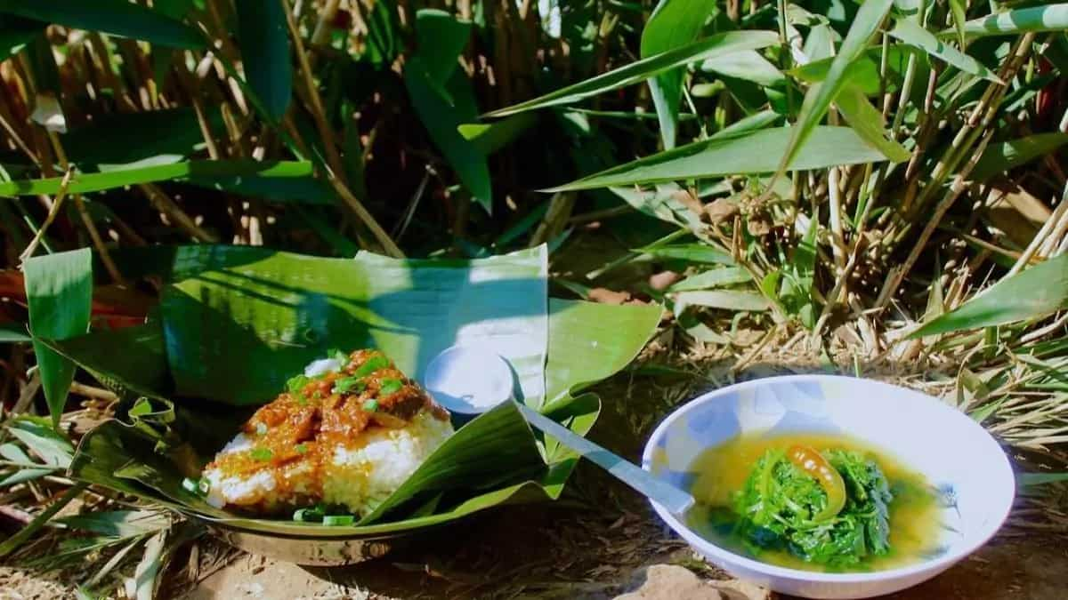
Traditional food of garo community
Traditional food of the Garo community includes rice, fermented fish, bamboo shoots, and meat dishes like beef, pork, and chicken. Popular dishes include "Pewtang" (meat curry) and "Katta" (fermented fish).

Slide 12
THANK YOU

